Slide 1



Department of Computer Science and Engineering
Facilitating Agricultural Development through Land Renting
SAMEEM AKTHAR S / 211420104336
SUNIL KUMAR / 211420104338
NUTHAN REDDY C/ 211420104048
Guide Name &Designation
Mrs.JENNIFER
Coordinator Name & Designation
Dr. Pughazendi N

Slide 2
Introduction
In recent years, the practice of landowners renting out free land for agricultural purposes has emerged as a noteworthy phenomenon with implications for both rural economies and agricultural sustainability.
This trend reflects a shift in land management strategies, as some landowners choose to unlock the agricultural potential of their idle lands by making them available to local farmers. This study endeavors to comprehensively explore the motivations driving landowners to engage in such practices,.
The decision of landowners to rent out free land for agriculture is multi-faceted and influenced by a combination of economic, social, and environmental factors. Rising concerns about optimal land use, the desire to support local farming communities, and the potential for additional income generation are among the key drivers.

Slide 3
Abstract
This study examines the dynamics of land ownership, particularly focusing on landowners who possess free land and choose to rent it out for agricultural purposes. The research aims to shed light on the motivations, benefits, and challenges associated with land renting for agricultural activities.
By analyzing this phenomenon, the study seeks to contribute to a better understanding of the role of landowners in fostering agricultural development.
The research employs a mixed-methods approach, combining qualitative interviews with landowners, farmers, and agricultural experts, along with quantitative data analysis to assess the economic and social impact of land renting.
The study considers various factors influencing landowners' decisions to rent their land, such as financial incentives, social responsibility, and the desire to contribute to local agricultural development.

Slide 4
Problem Statement
This study aims to investigate the motivations, benefits, and challenges faced by landowners who choose to rent out their free land for agricultural purposes. Specifically, the research seeks to understand the dynamics of land ownership in the context of agricultural development and the role of landowners in fostering this development.
Through a mixed-methods approach involving qualitative interviews with landowners, farmers, and agricultural experts, as well as quantitative data analysis, the study aims to uncover the factors influencing landowners' decisions to rent their land.
By doing so, it endeavors to contribute to a deeper understanding of the socio-economic implications of land renting for agricultural activities and to provide insights for policymakers and stakeholders involved in promoting agricultural development.

Slide 5
Literature Review
Development and Application of Land-use Planning Management Information System Based on ArcGIS
AUTHORS:
Zhang He-bing - Institute of Surveying and Land Information Engineering, Henan Polytechnic University (HPU), Jiaozuo, 454003, China
Zhao Su-xia - Institute of Surveying and Land Information Engineering, Henan Polytechnic University (HPU), Jiaozuo, 454003, China
DESCRIPTION: The LUPMIS based on ArcGIS helps people manage and understand information about how land is being used in a certain area. It allows users to view maps, analyze data about different land uses (like farming or urban development), and make plans for how to best use the land. It also helps with tasks like tracking changes in land use over time and making sure that land use plans are followed properly.
ADVANTAGE:
The advantage is that it makes it easy to combine and understand both the maps and the information about the land, helping people to make better decisions about how to use the land wisely. DISADVANTAGE:
It only helps to how to use the land , doesn't allow users to buy/rent the land

Slide 6
Theoretical Background
Proposed Methodology
Implementation Environment
System Architecture

Slide 7
Proposed Methodology
Existing System
Land Management Software: Some land management software solutions cater to landowners managing agricultural properties. These systems may include features for tracking leases, monitoring soil health, and managing overall land productivity. Examples include Granular and Trimble's Land Management.
Real Estate and Land Listing Websites: Traditional real estate and land listing websites may have sections dedicated to agricultural properties for rent. Landowners often use these platforms to advertise available land.
Local Agricultural Co-operatives: Agricultural co-operatives may facilitate the renting of land among their members. These co-operatives can provide a platform for collaboration and resource-sharing among local farmers

Slide 8
Proposed Methodology
Proposed System
The proposed system helps in renting the lands and getting land for rents.
Landowners and potential renters/buyers can register with basic information , required details: name, contact, address.
Landowners can list land for rent or sale with detailed information, includes location, size, features, and images.
Users can search for land based on location, size, price, etc.
Renters/buyers can directly contact landowners through provided details.

Slide 9
Implementation Environment
Agricultural lands
Garden
Buildings
Vegetable farmland

Slide 10
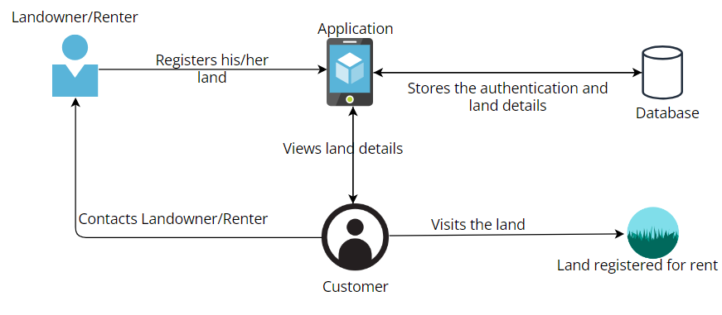
System Architecture

Slide 11
System Implementation
Android Studio
XML(Frontend-App)
Java(Backend-App)
Firebase Console
Stores user’s credentials
Stores images and bills
Google console
Gives access to map
Finds current location

Slide 12
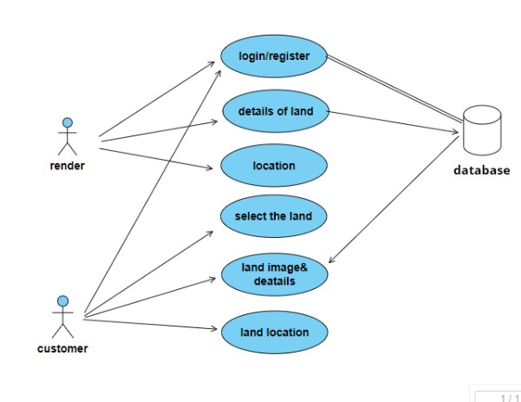
Usecase Diagram

Slide 13
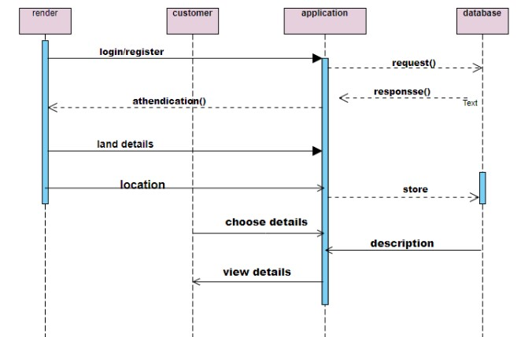
Sequence Diagram

Slide 14
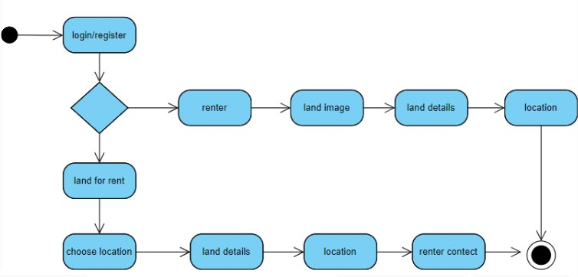
Activity Diagram

Slide 15
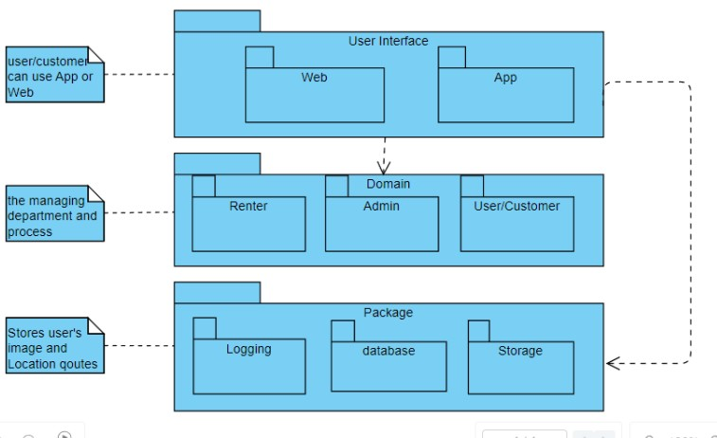
Package Diagram

Slide 16
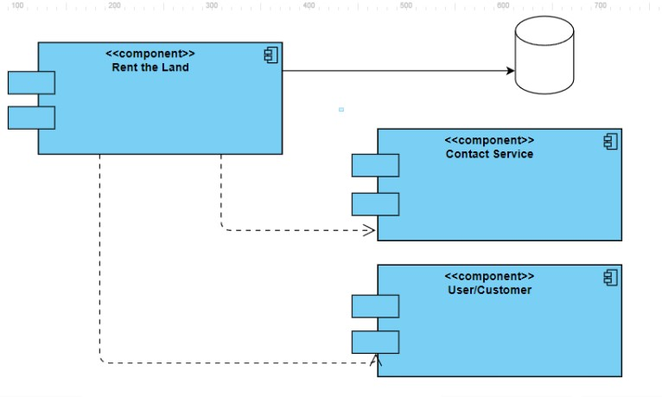
Component Diagram

Slide 17
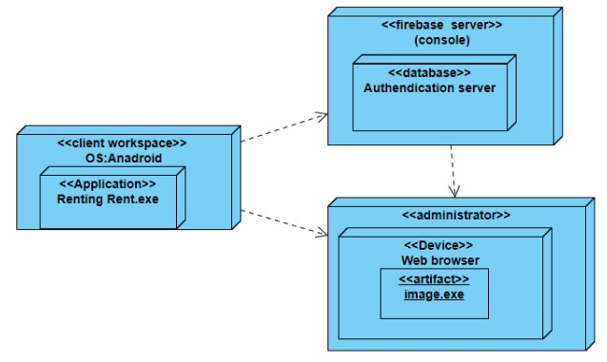
Deployment Diagram

Slide 18
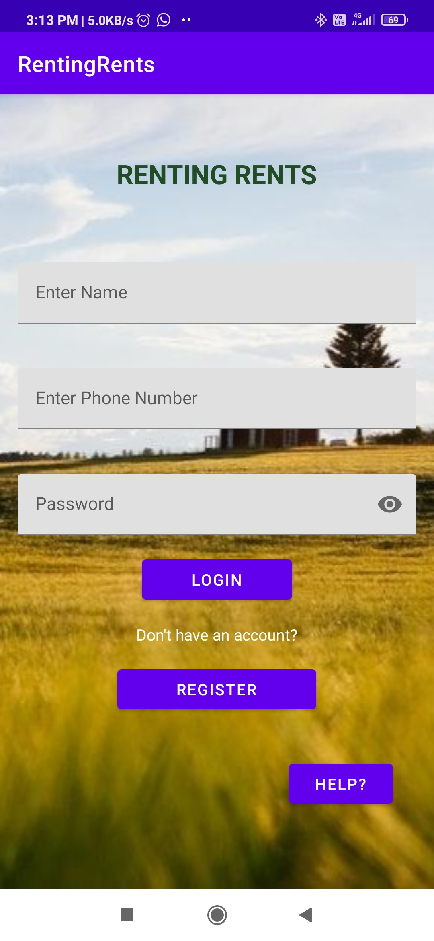
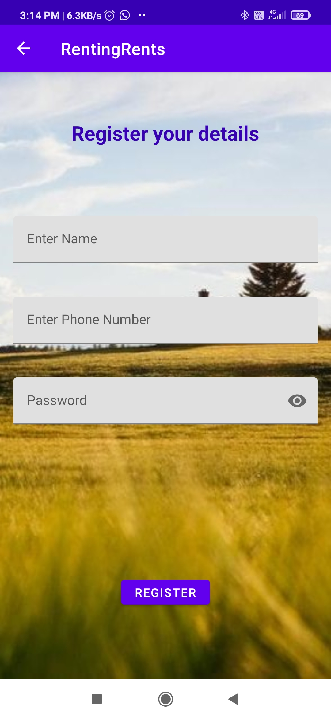
ScreenShot

Slide 19
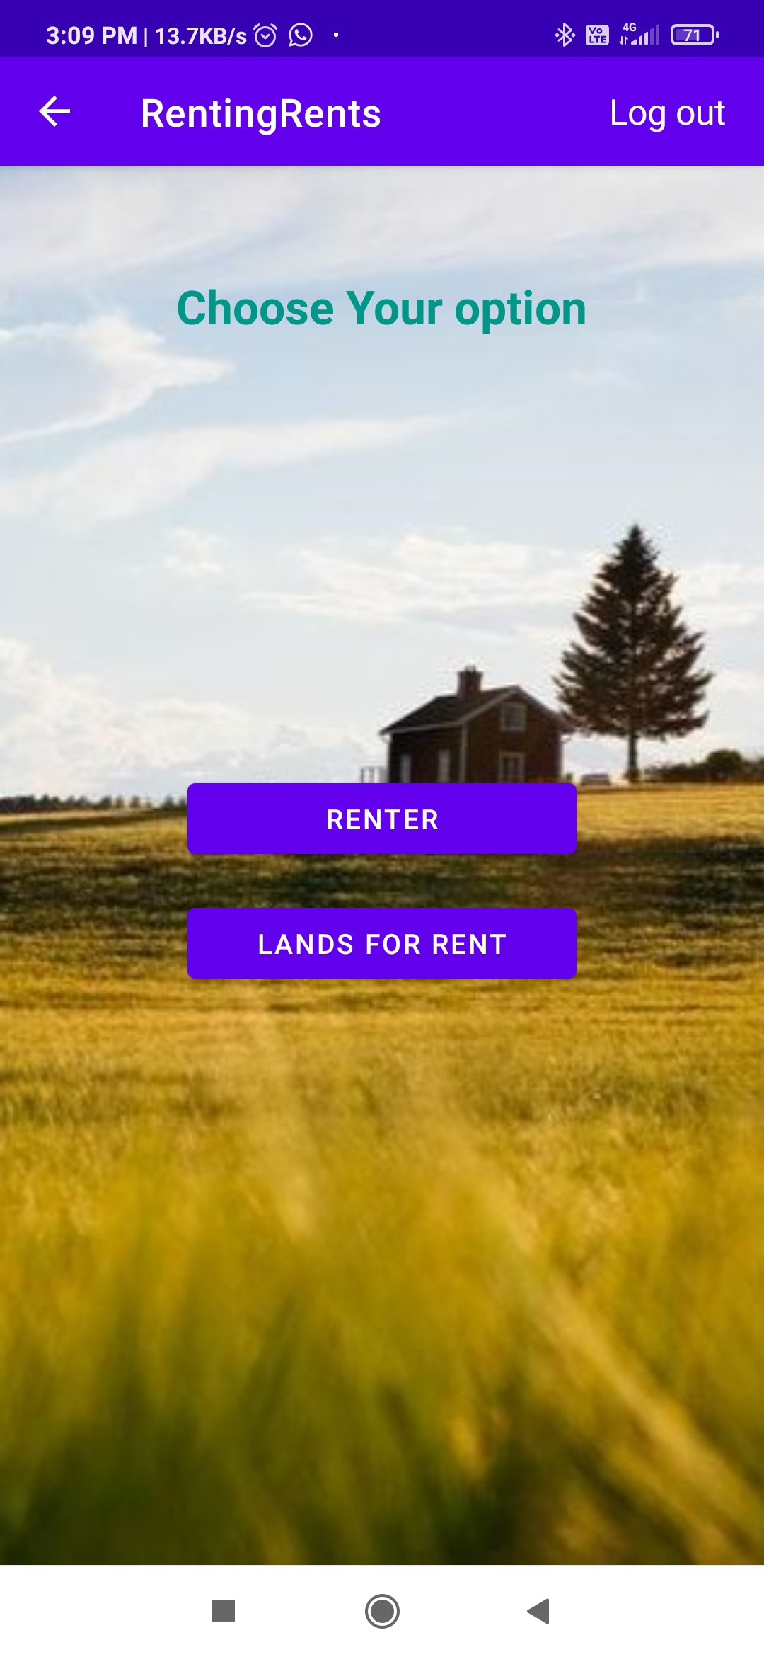
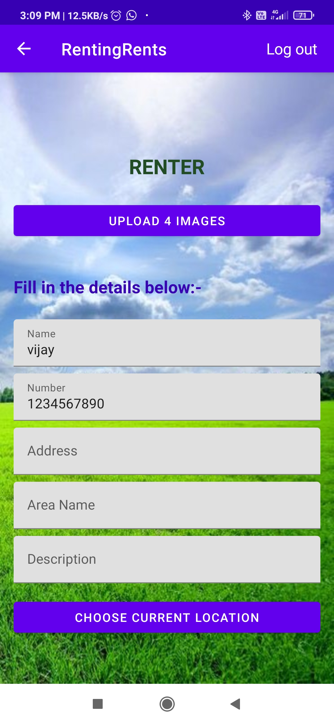

Slide 20
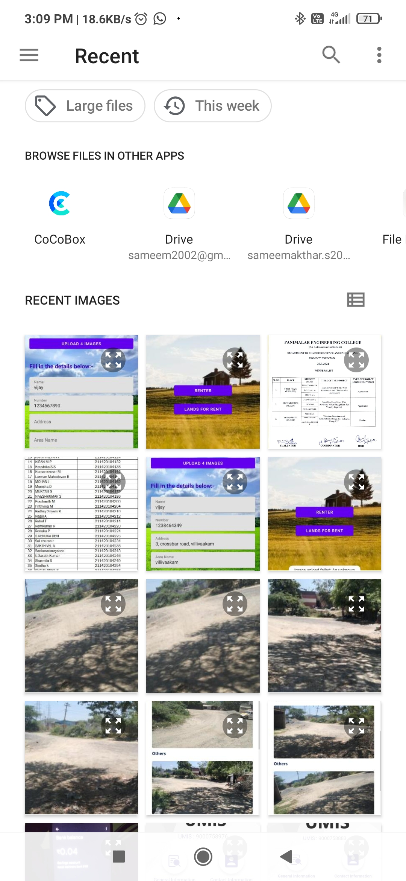

Slide 21
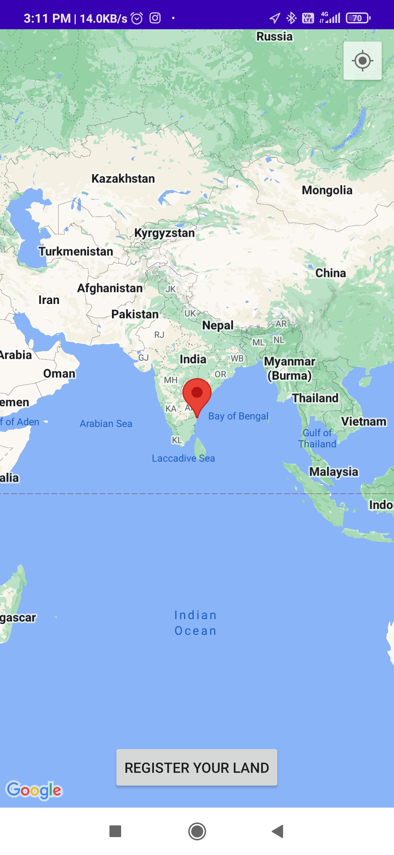
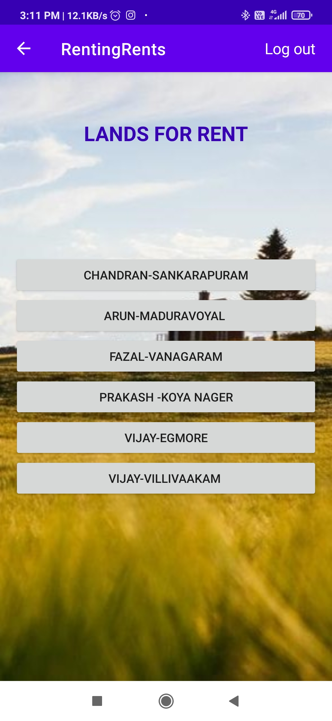

Slide 22
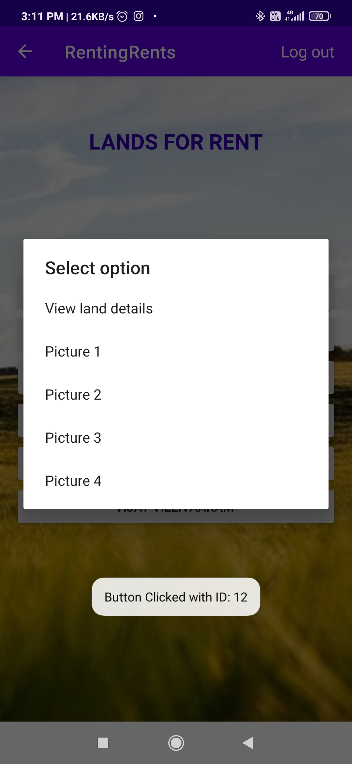
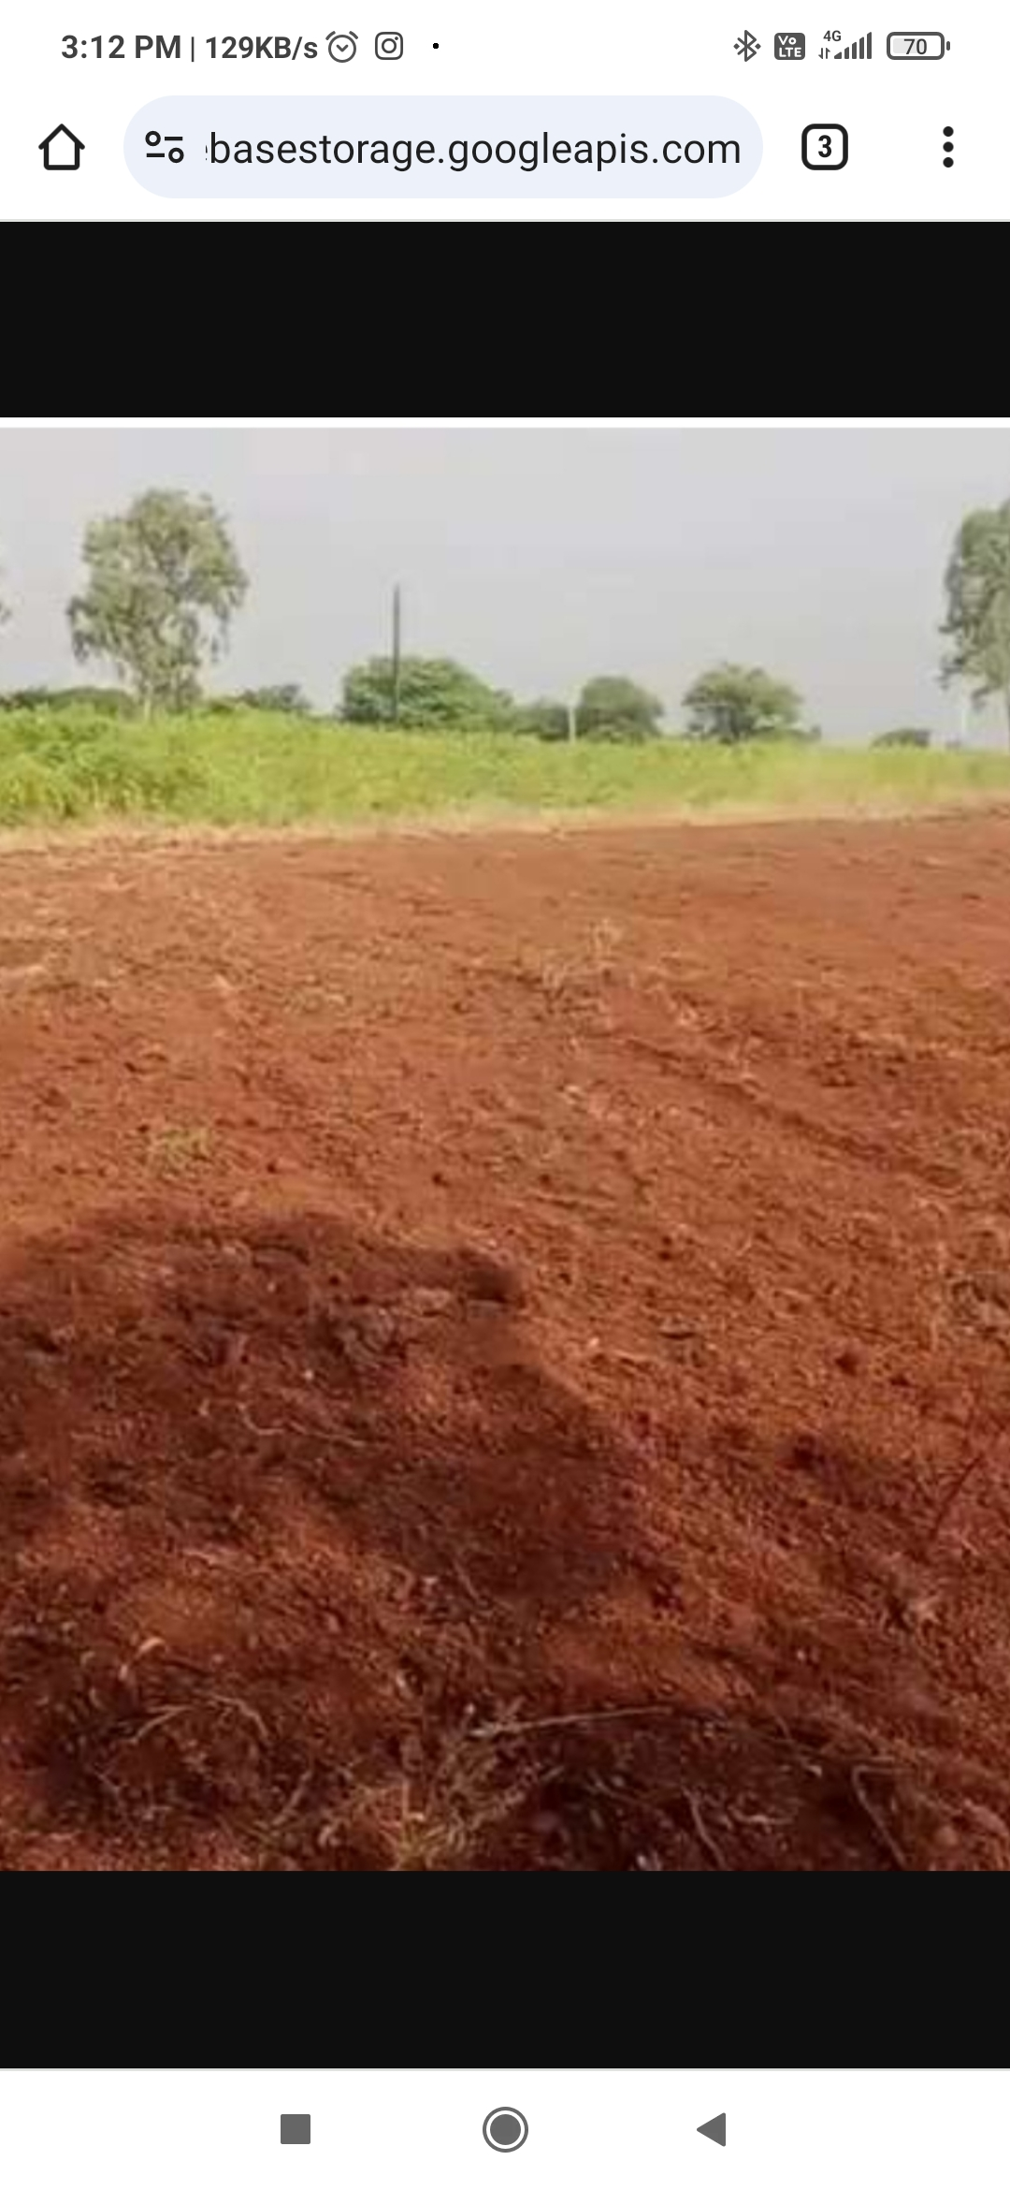

Slide 23
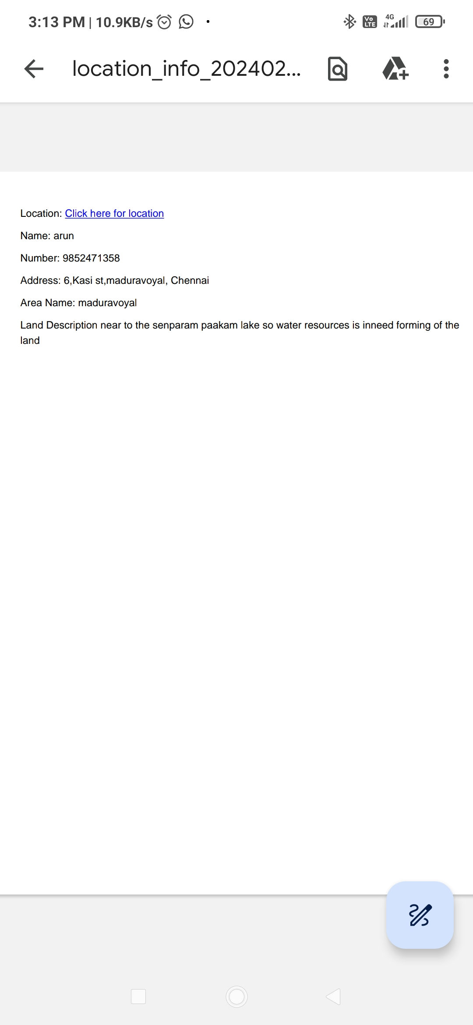

Slide 24
RESULTS AND DISCUSSION
1. Recap of Objectives:
Remind the reader of the primary goals of the project, such as enhancing agricultural productivity, promoting land access for smallholder farmers, or improving rural livelihoods.
2. Summary of Methodology:
Briefly describe the methods used to conduct the project, including data collection techniques, analysis procedures, and any interventions implemented.

Slide 25
RESULTS AND DISCUSSION
3. Results Overview:
Impact on Agricultural Productivity:
Discuss any improvements observed in crop yields, livestock production, or other productivity metrics as a result of the land renting arrangements.
Land Access and Equity:
Evaluate the extent to which land renting facilitated access to land for smallholder farmers or marginalized groups, and discuss any implications for social equity and inclusivity.

Slide 26
RESULTS AND DISCUSSION
4. Discussion of Findings:
Successes and Challenges:
Highlight the achievements of the project and identify any obstacles encountered during implementation.
Factors Influencing Effectiveness:
Discuss the factors that contributed to the outcomes observed, such as regulatory frameworks, market conditions, social norms, or institutional support.

Slide 27
RESULTS AND DISCUSSION
5. Limitations and Future Research:
Acknowledge any limitations of the study, such as sample size constraints, data quality issues, or methodological biases. Suggest areas for further research to address unanswered questions or explore new dimensions of the topic.

Slide 28
CONCLUSION
Summarize the main findings and implications of the project, emphasizing
its contributions to agricultural development, livelihood improvement, and
sustainable land management. Offer closing remarks on the significance of
the study and its potential to inform future policy and practice.
By following this structured approach, you can effectively communicate
the results and implications of your project on facilitating agricultural
Development through land renting.

